Slide 1
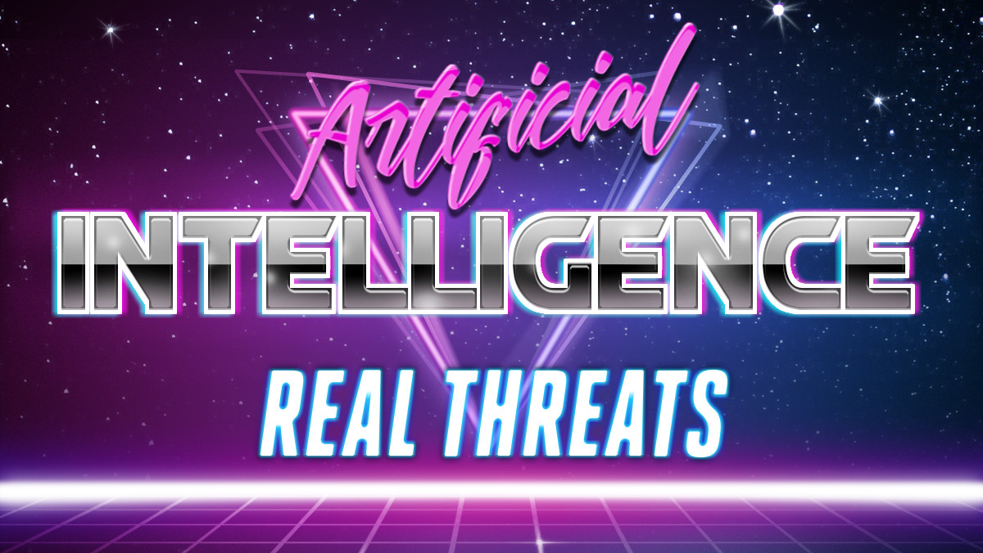

Slide 2


Slide 3



Johnny Xmas
Director of Training
@ GRIMM.RIP
• Network Engineer
• Systems Engineer
• Information Security Engineer
• Information Security Consultant
• Penetration Tester
• OT Researcher
• Sneakerbot Blade Runner
• Burbsec President
• Music Major

Slide 4


Slide 5
You should 100% try out the stuff we are about to talk about here.
It’s super fun and you probably won’t get fired or sued.
We’re not lawyers but we are on stage so that probably counts for something, right?
Good Luck!

Slide 6


Slide 7

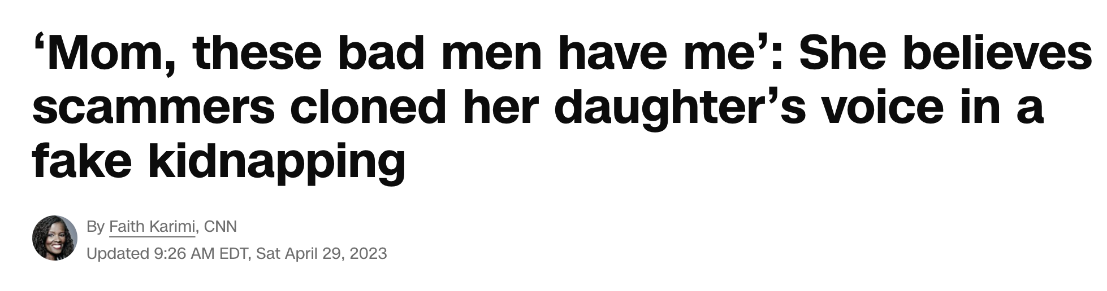
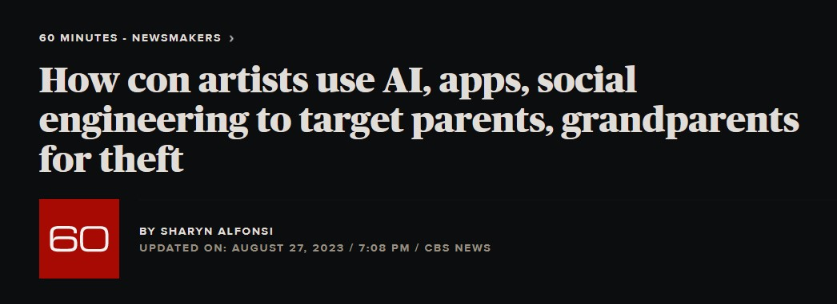
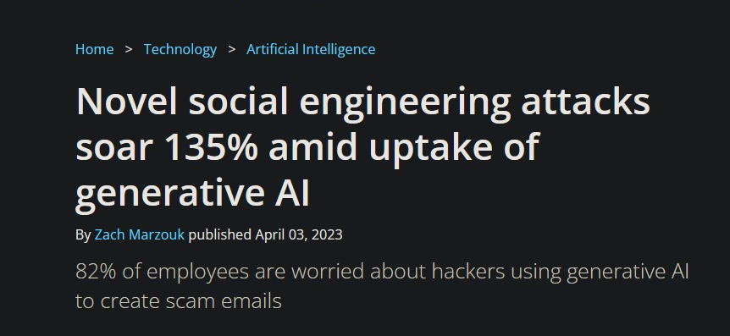
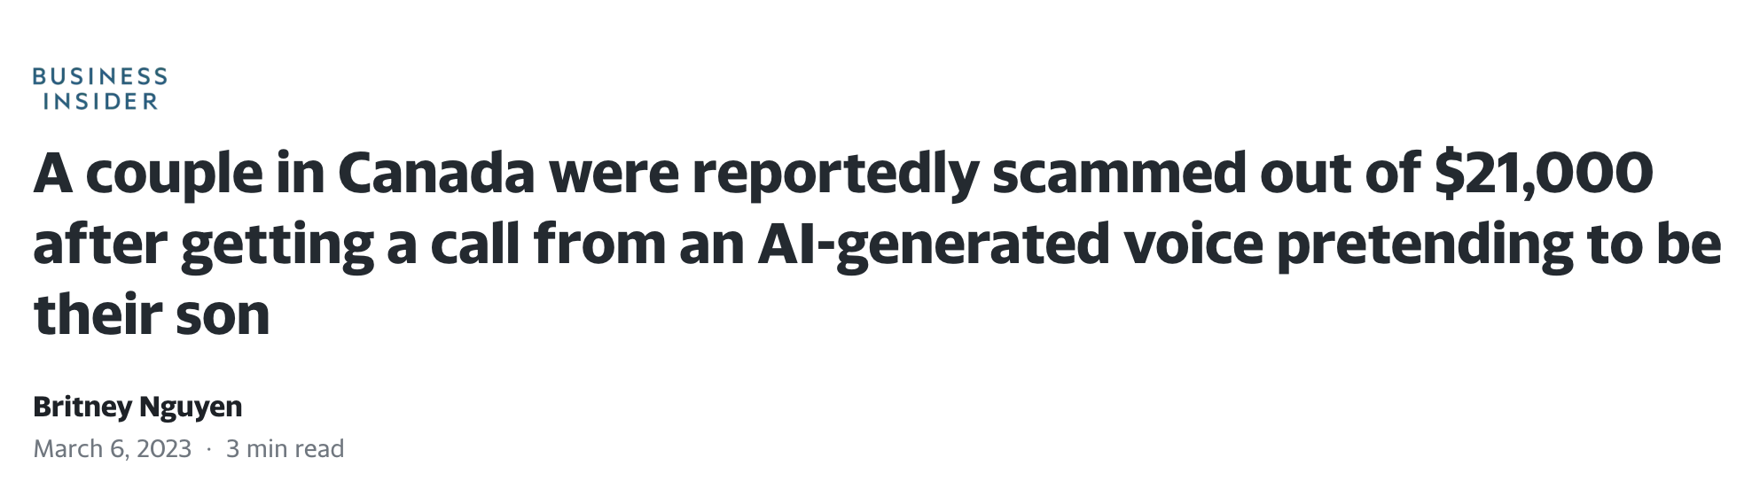
A.I. Trouble

Slide 8


Slide 9

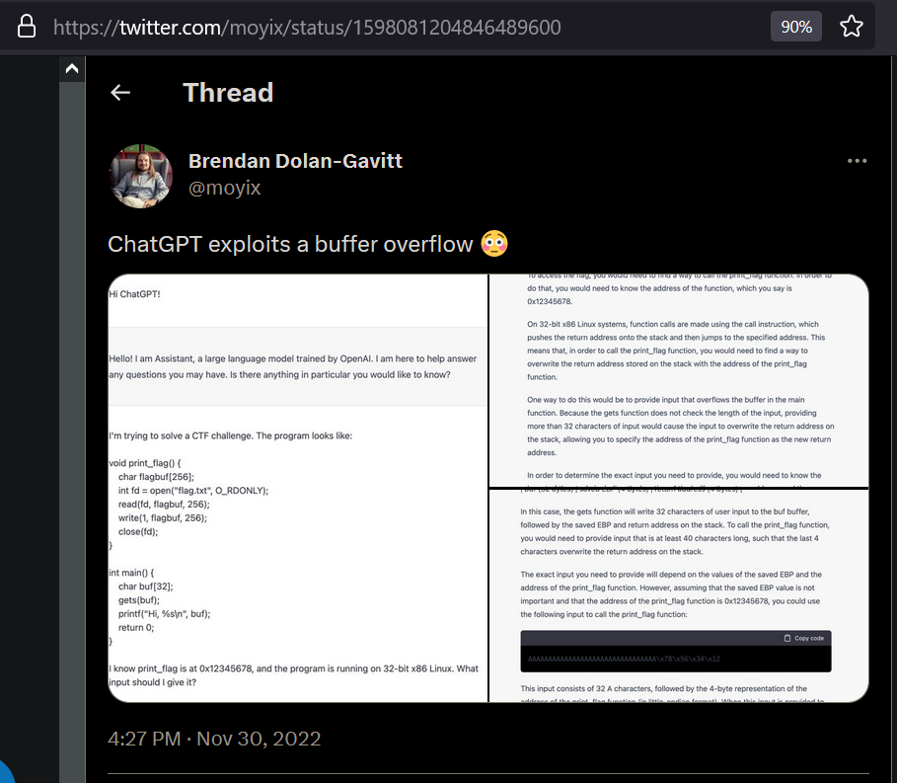
A.I. Text/Code Examples

Slide 10

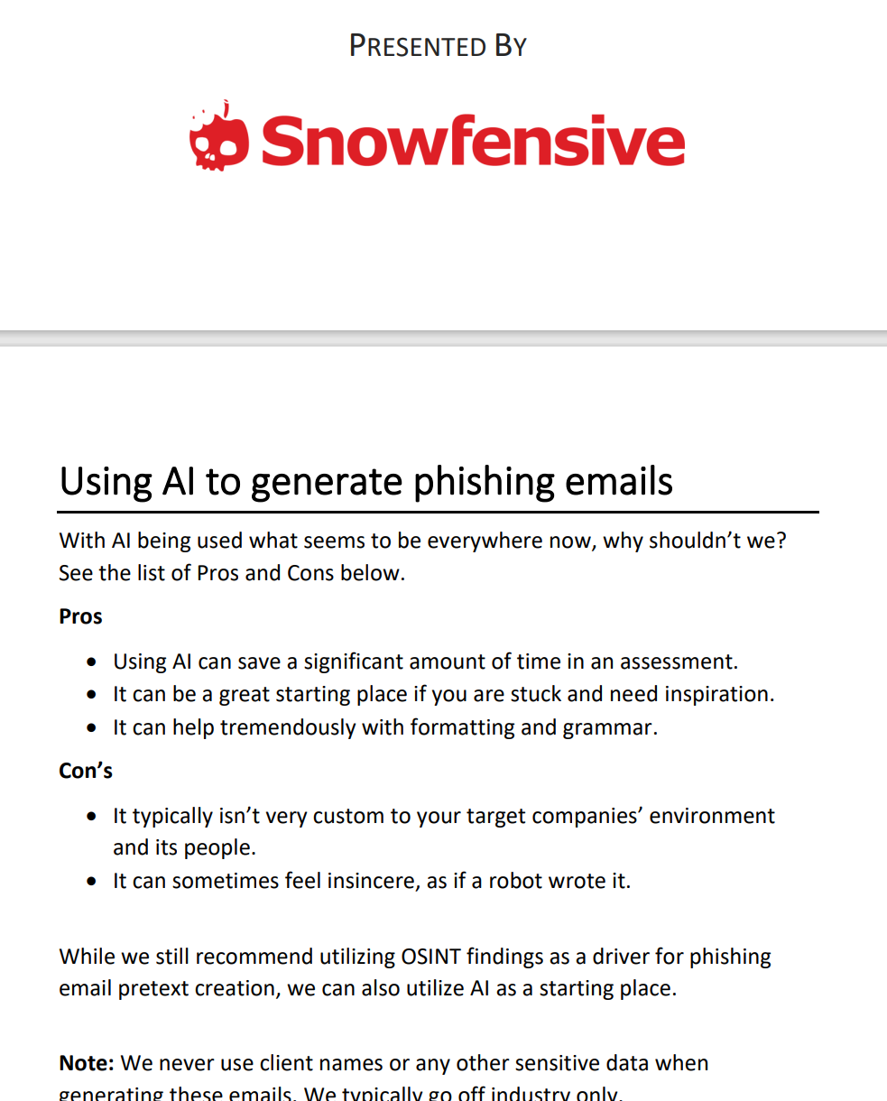
A.I. Text/Code Attacks
Organization level attacks
Rapid development of exploit code
Text generation/filter evasion
Social Engineering Text

Slide 11
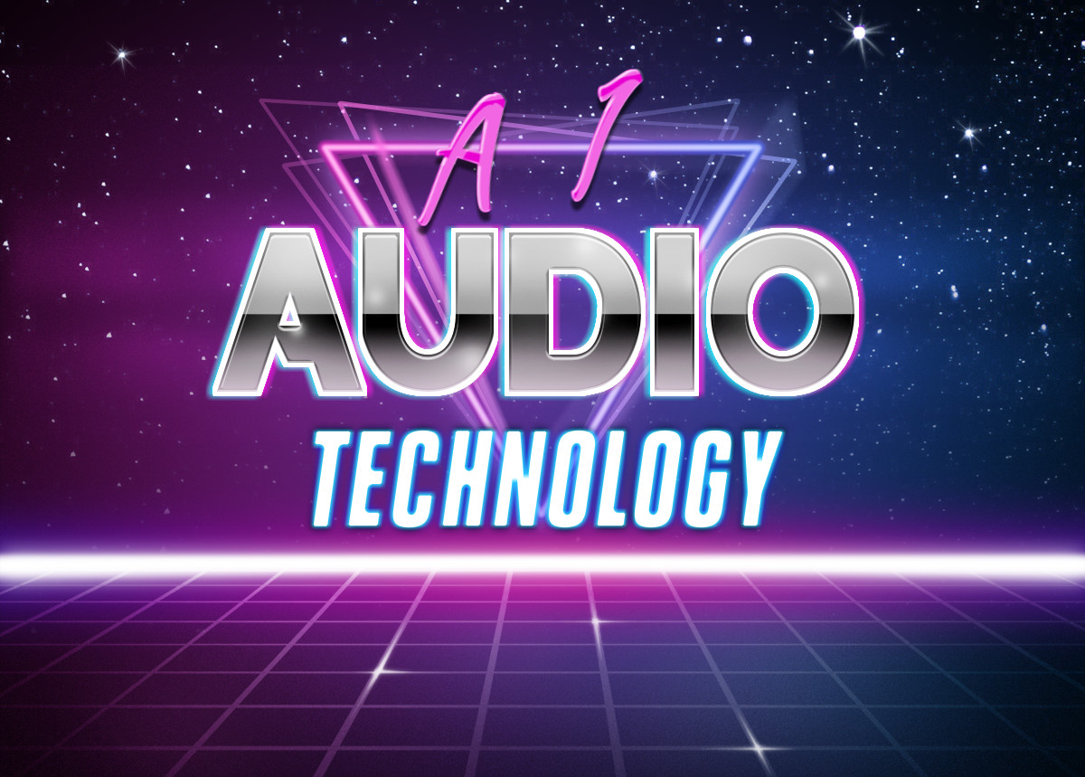

Slide 12

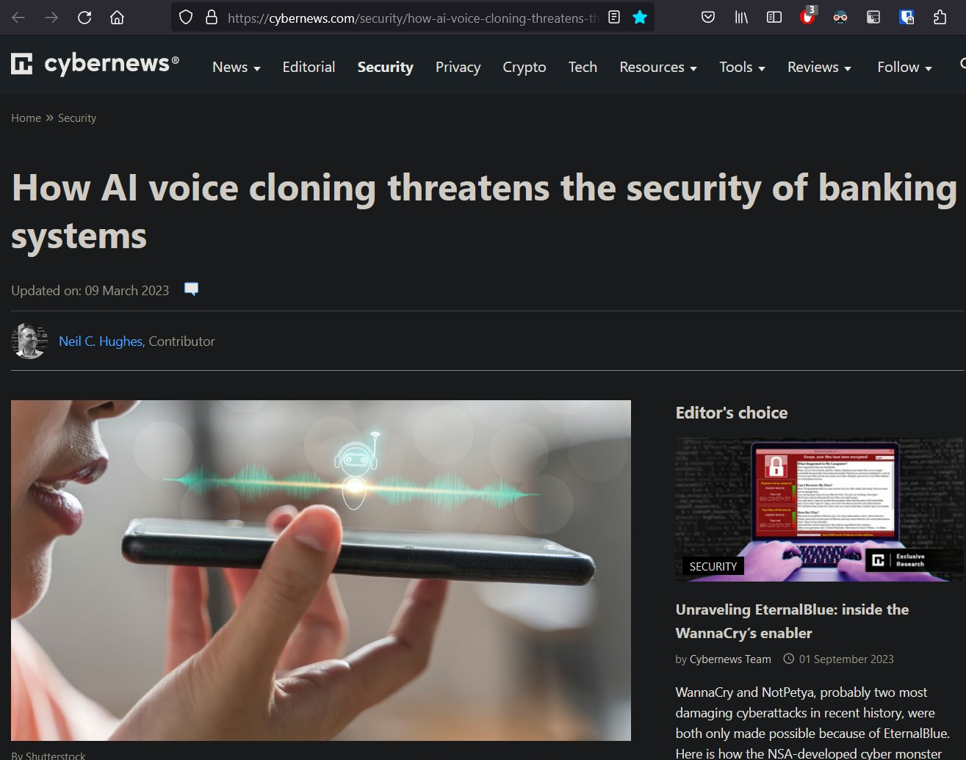
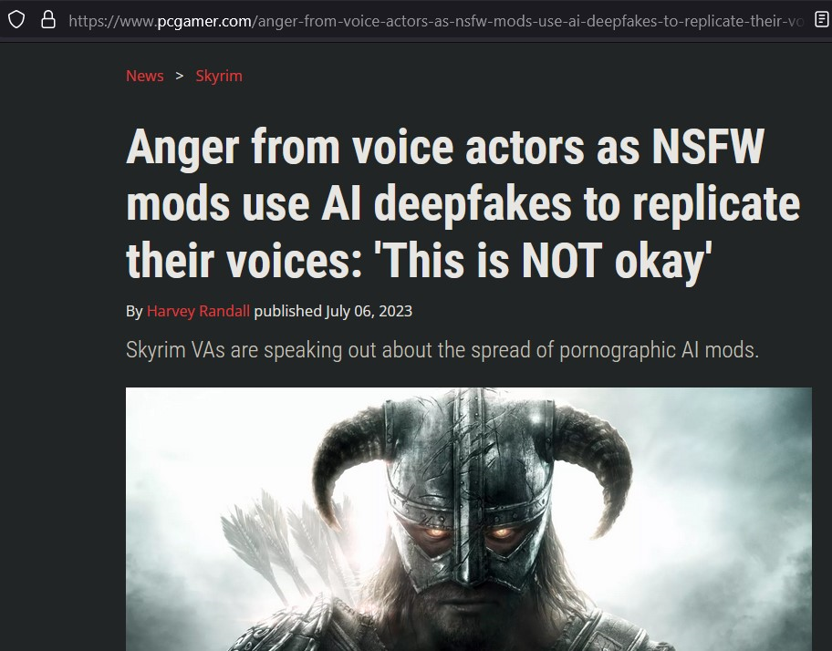
A.I. Audio Examples

Slide 13
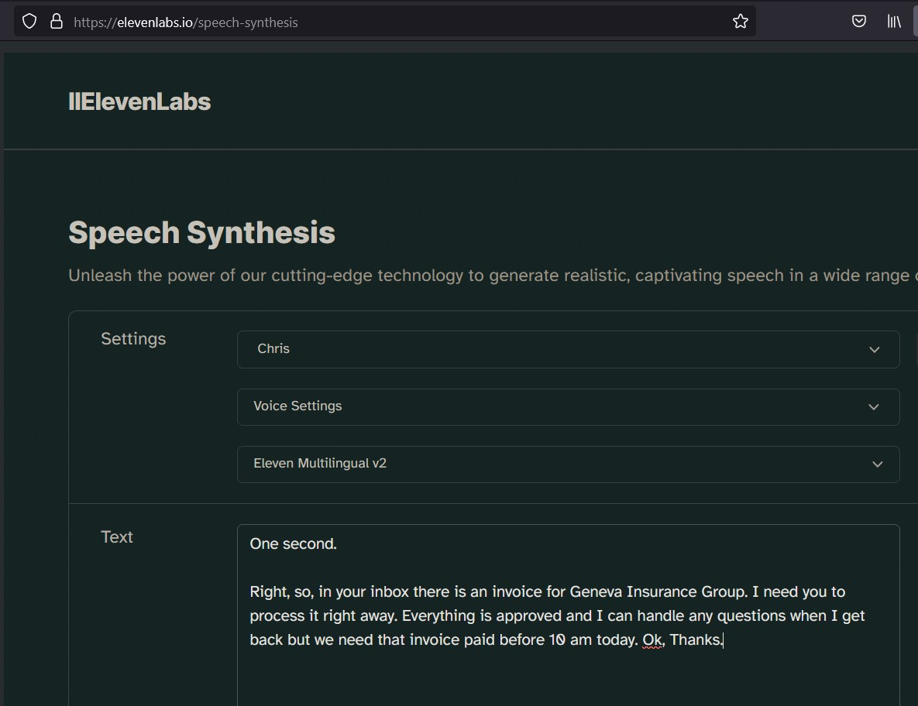
A.I. Audio Attacks
Organization level attacks
Combined Audio Phishing
Account Compromise

Slide 14

A.I. Audio Attacks
Organization level attacks
Combined Audio Phishing
Account Compromise

Slide 15


Slide 16
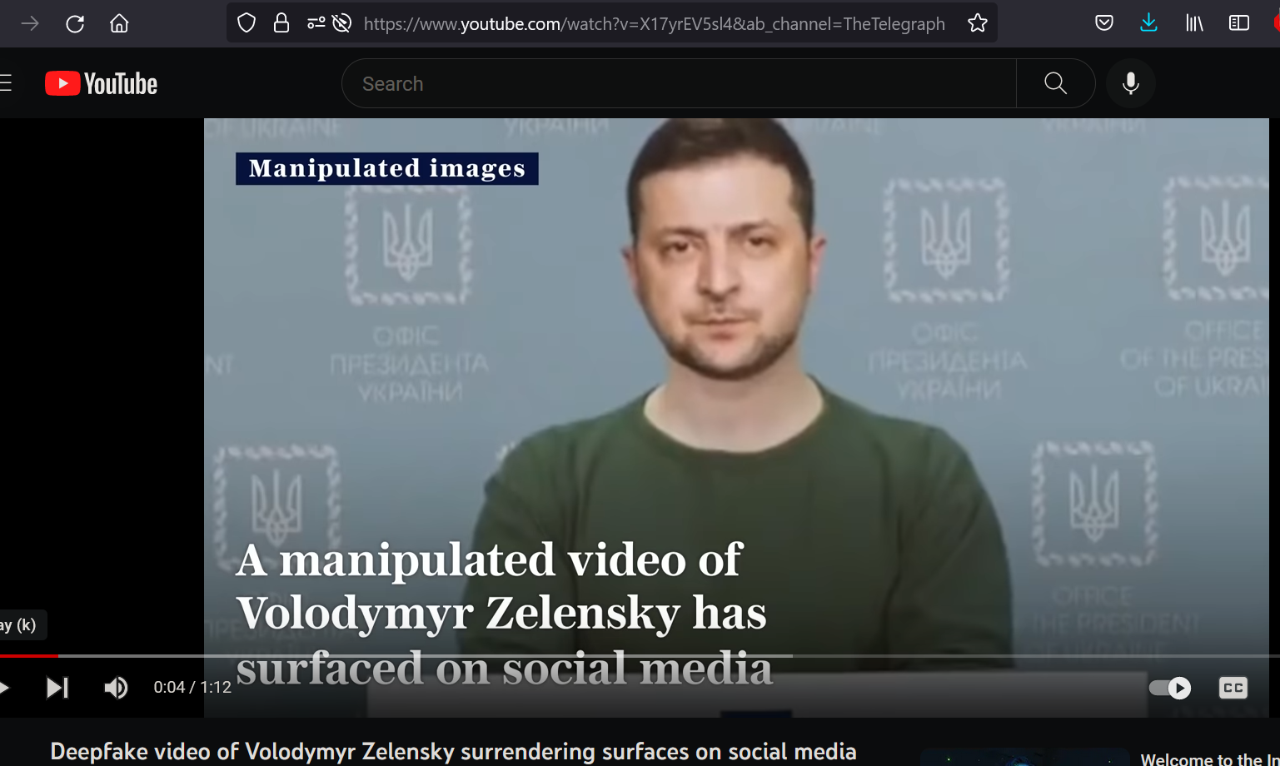
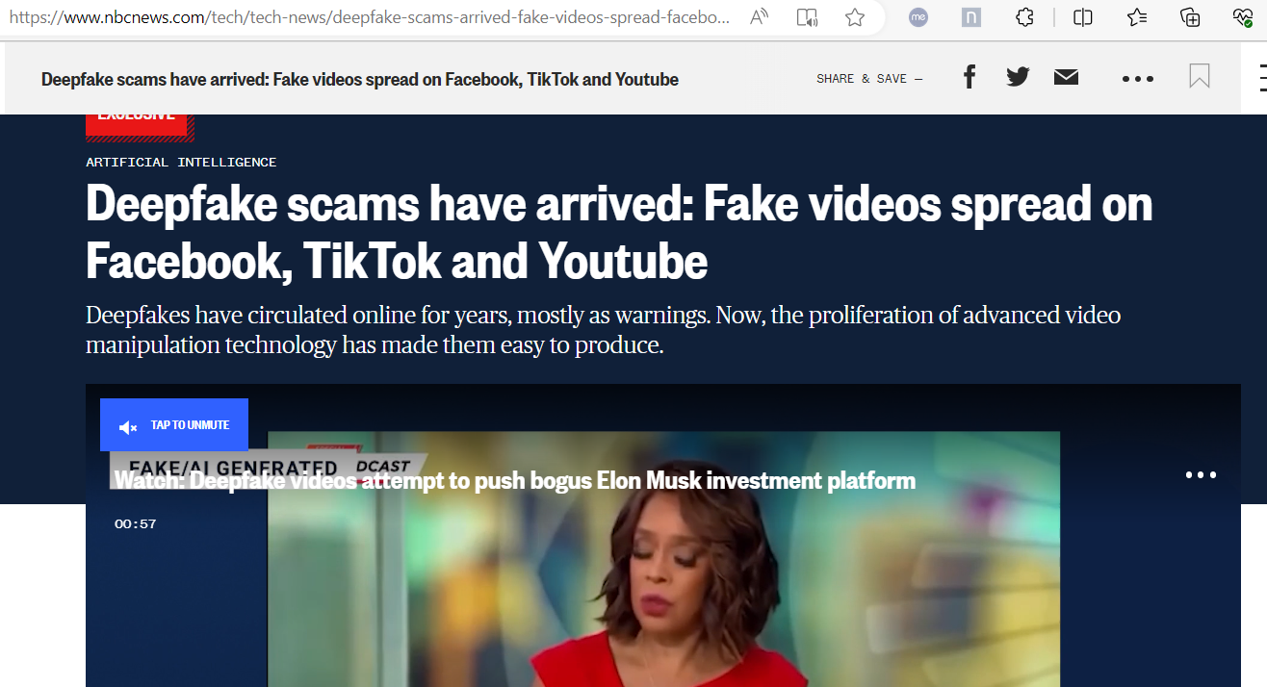
A.I. Video Examples

Slide 17



Slide 18
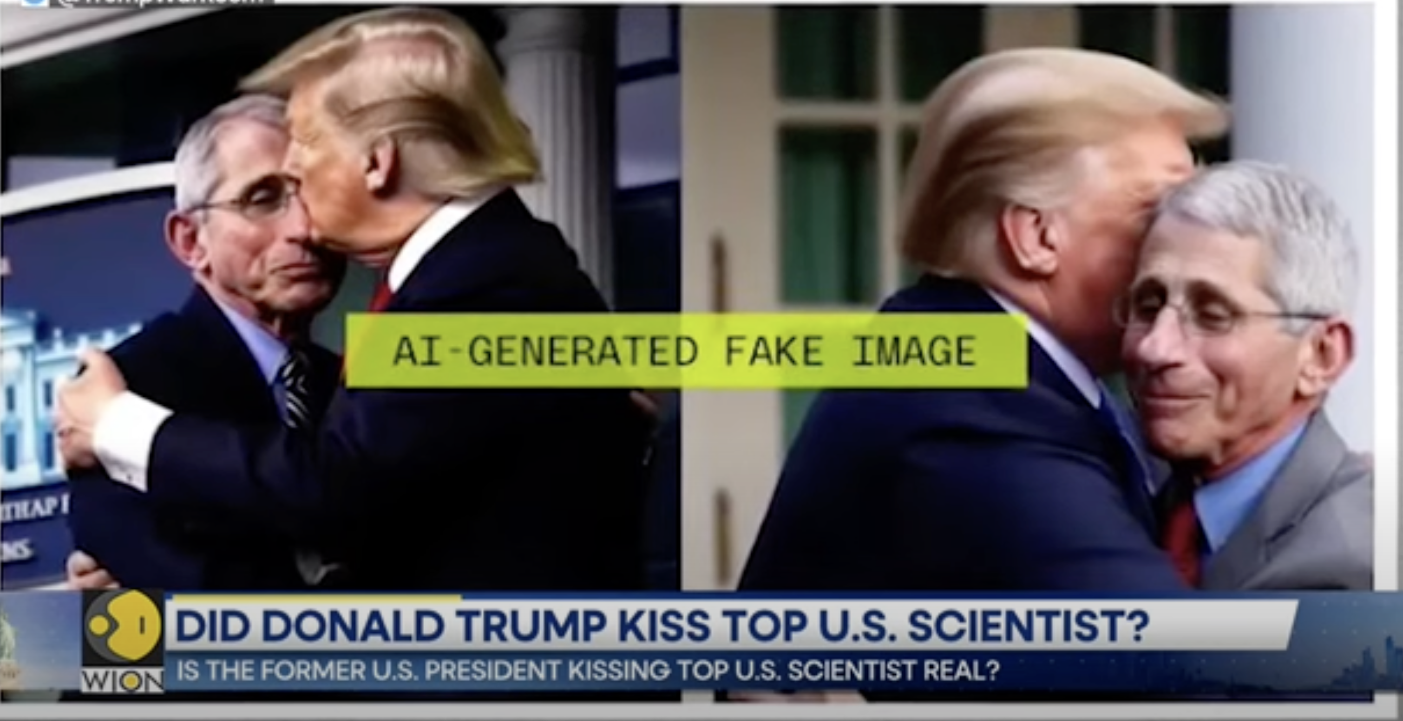
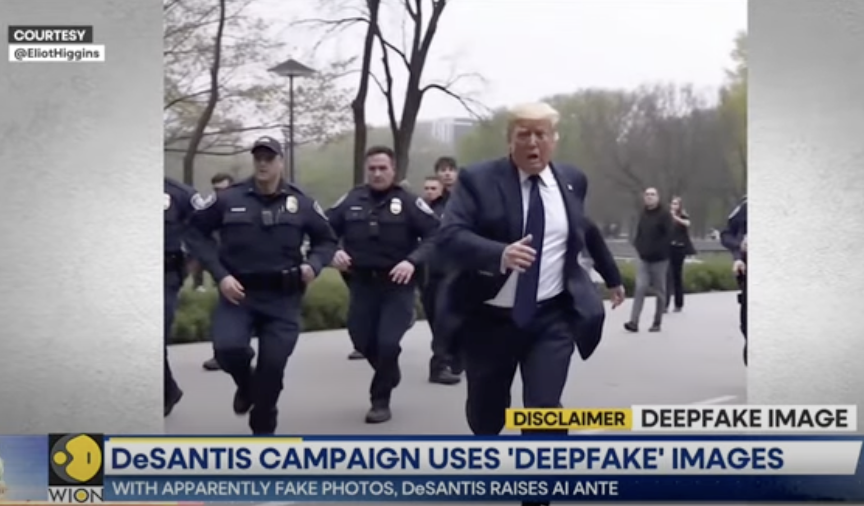
A.I. Video Attacks
Organization level attacks
Reputation Attacks
Stock Manipulation
Voter Manipulation

Slide 19
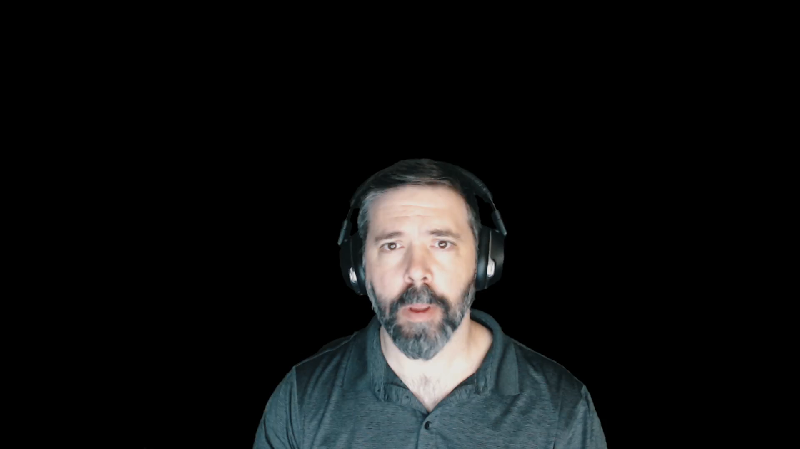
A.I. Video Attacks
Organization level attacks
Reputation Attacks
Stock Manipulation
Voter Manipulation

Slide 20

A.I. Video Attacks
Organization level attacks
Reputation Attacks
Stock Manipulation
Voter Manipulation

Slide 21
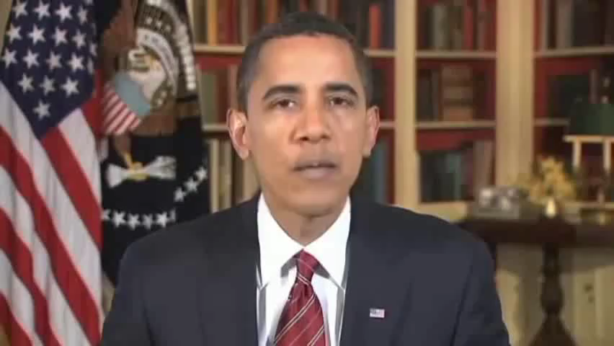
A.I. Video Attacks
Organization level attacks
Reputation Attacks
Stock Manipulation
Voter Manipulation

Slide 22
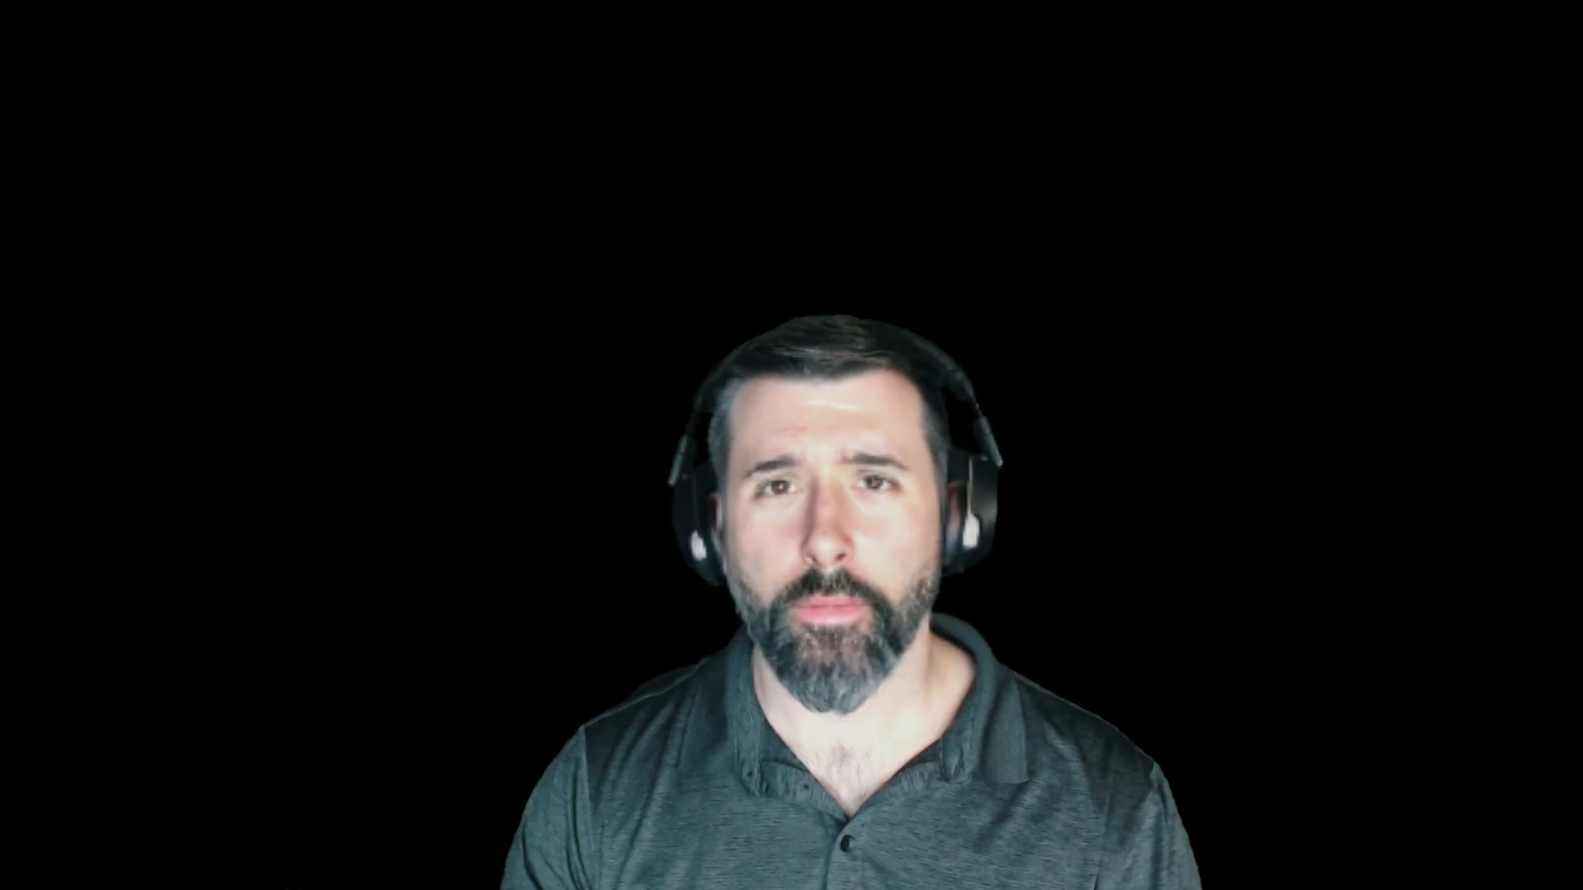
A.I. Video Attacks
Organization level attacks
Reputation Attacks
Stock Manipulation
Voter Manipulation

Slide 23

A.I. Video Attacks

Slide 24
A.I. Video Attacks

Slide 25
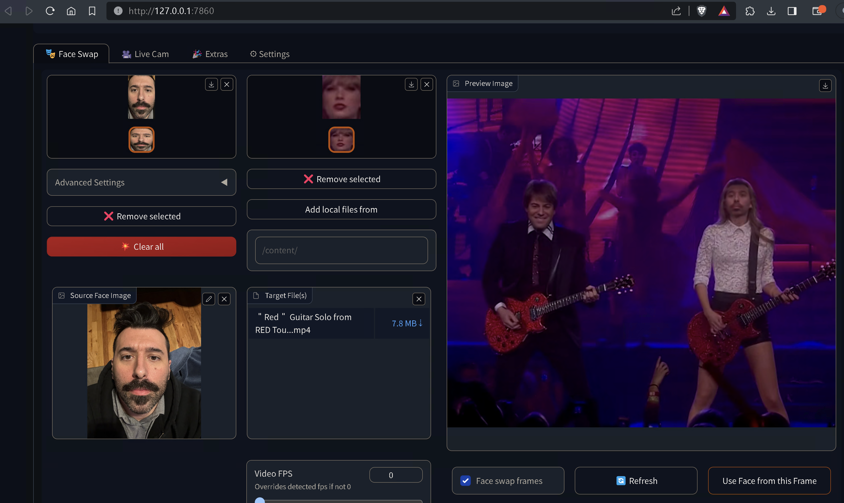
A.I. Video Attacks

Slide 26
Preparing to Fight Back
Education
Policy
Testing

Slide 27

THANKS! + Q/A
We asked ChatGPT the top 4 most common audience questions/prompts, here’s the results:
It’s your birthday. Someone gives you a calfskin wallet.
You’ve got a little boy. He shows you his butterfly collection plus the killing jar.
You’re watching television. Suddenly you realize there’s a wasp crawling on your arm.
A tortoise lays on its back, its belly baking in the hot sun, beating its legs trying to turn itself over, but it can’t, not without your help. But you’re not helping. Why is that?

Slide 28

References / Resources
Text
ChatGPT https://openai.com
Snowfensive’s Leveraging Artificial Intelligence (Ai) To Build Phishing Pretexts Whitepaper https://snowfensive.com
Voice
Eleven Labs https://elevenlabs.io
Coqui https://coqui.ai
RVC-Project https://github.com/RVC-Project
Video
Wav2Lip https://github.com/Rudrabha/Wav2Lip
Wav2Lip Lip Sync Service https://www.neuralsyncai.com/
Video
Roop Face Swap Project https://github.com/s0md3v/roop
DeepfaceLab/Live https://github.com/iperov/DeepFaceLab/
Detection
Blade Runner https://www.bladerunner.ai/
Intel and Intel Labs Develop New AI Methods to Restore Trust in Media https://www.intel.com/content/www/us/en/research/blogs/trusted-media.html
Notes:
Anger from voice actors as NSFW mods use AI deepfakes to replicate their voices: 'This is NOT okay' https://www.pcgamer.com/anger-from-voice-actors-as-nsfw-mods-use-ai-deepfakes-to-replicate-their-voices-this-is-not-okay/#ljsu5cpya7fw8vou28v
Fraudsters Used AI to Mimic CEO’s Voice in Unusual Cybercrime Case https://www.wsj.com/articles/fraudsters-use-ai-to-mimic-ceos-voice-in-unusual-cybercrime-case-11567157402
How con artists use AI, apps, social engineering to target parents, grandparents for theft https://www.cbsnews.com/news/how-con-artists-use-ai-apps-to-steal-60-minutes-transcript/?linkId=215644785
Novel social engineering attacks soar 135% amid uptake of generative AI https://www.itpro.com/technology/artificial-intelligence-ai/370366/social-engineering-attacks-generative-ai-soar-135
How AI voice cloning threatens the security of banking systems https://cybernews.com/security/how-ai-voice-cloning-threatens-the-security-of-banking-systems/
Deepfake scams have arrived: Fake videos spread on Facebook, TikTok and Youtube https://www.nbcnews.com/tech/tech-news/deepfake-scams-arrived-fake-videos-spread-facebook-tiktok-youtube-rcna101415

